Slide 1
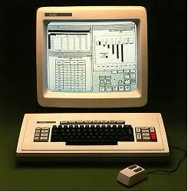
The GUI Challenge
Left – What the client likely doesn’t want – something that looks really old-fashioned.
CSSE 371, Fall, 2013
“What to do for the client meeting”
Week 4
Notes:
GUI example from http://www.theoligarch.com/microsoft_vs_apple_history.htm

Slide 2
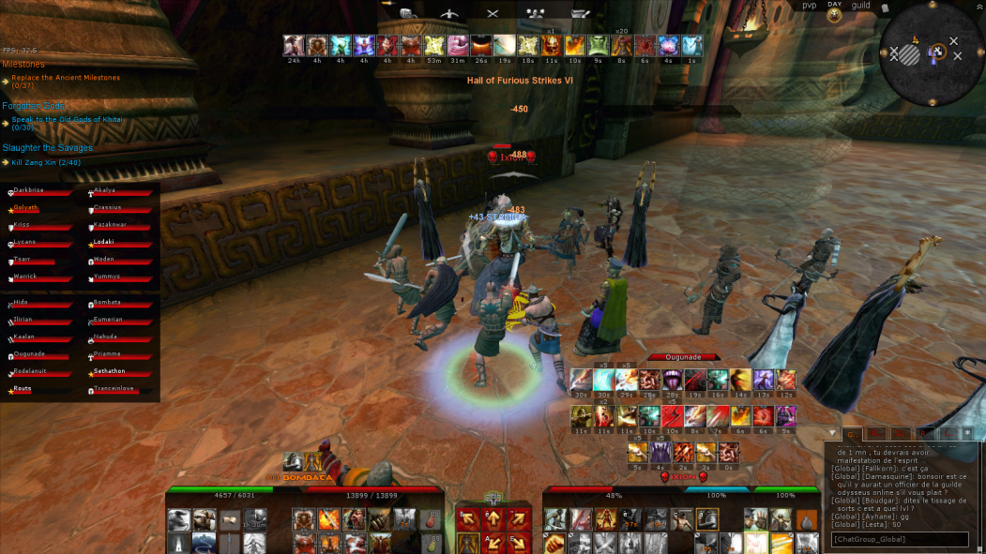
Last Friday, you showed 5 GUI’s
Your client liked them
But, how do you decide what the overall “rules” of the GUI will be.
For now, make these “minimalist” rules.
But also try for consistency.
Assume we’ll change it all later!
Right – Something else they may not want – a GUI that assumes you are familiar with something unrelated.
Notes:
GUI example from http://forums-us.ageofconan.com/showthread.php?p=2756037.

Slide 3
The method…
Like last week, let’s form a cross-team team
New people, this time
They will create a set of “rules” by tomorrow night, and post these on Google Groups.
Sound doable?
Then everyone will try to follow these for this coming Friday’s client meeting.
What kind of “prototype” will we do this week?

Slide 4
The GUI prototype
A “paper prototype” of your part of the system, from each team.
You’ll take turns showing this to the client, on Friday.
It should allow you to step through all your team’s key use cases with them.
The Friday meeting will have to be efficient, because it covers more territory.

Slide 5
This is described in ID book, Ch 11
See pp 423-425.
The YouTube video at https://www.youtube.com/watch?v=GrV2SZuRPv0 is really good!
Shows how fast you can go through it, guiding the client through the steps.
How many of these would you need for your part of the system?

